Slide 1
SENG2260 Human-Computer Interaction
Week 8: Data Analysis, Interpretation and Presentation
All images in this presentation are either licenced or labelled for reuse on Google Images.

Slide 2

Lecture Aims
Discuss the difference between qualitative and quantitative data and analysis.
Enable you to analyze data gathered from:
Questionnaires.
Interviews.
Observation studies.
Make you aware of software packages that are available to help your analysis.
Identify common pitfalls in data analysis, interpretation, and presentation.
Enable you to interpret and present your findings in appropriate ways.

Slide 3


Chapter 8
Data Analysis, Interpretation and Presentation
Chapter 9
Data Analysis, Interpretation and Presentation

Slide 4
Quantitative and qualitative
Quantitative data – expressed as numbers
Qualitative data – difficult to measure sensibly as numbers, e.g. count number of words to measure dissatisfaction
Quantitative analysis – numerical methods to ascertain size, magnitude, amount
Qualitative analysis – expresses the nature of elements and is represented as themes, patterns, stories
Be careful how you manipulate data and numbers!

Slide 5
Simple quantitative analysis
Averages
Mean: add up values and divide by number of data points
Median: middle value of data when ranked
Mode: figure that appears most often in the data
Percentages
Be careful not to mislead with numbers!
Graphical representations give overview of data
4

Slide 6
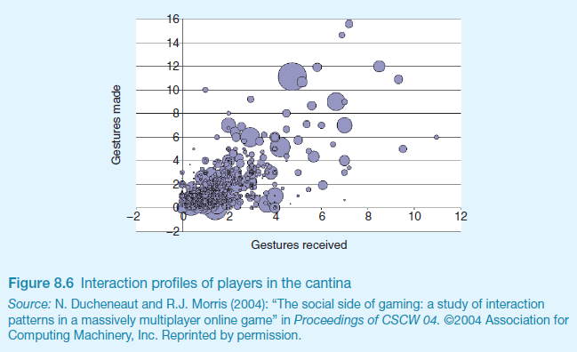
Visualizing log data
Interaction profiles of players in online game
Size of dot = public utterances

Slide 7
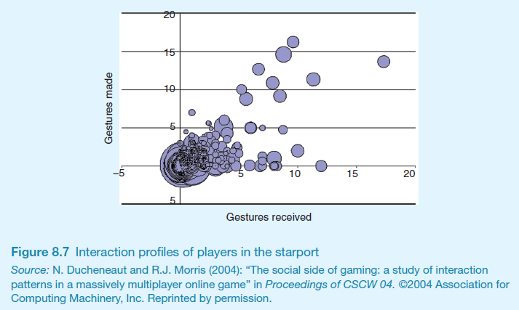
Visualizing log data
Log of web page activity
Size of dot = public utterances

Slide 8
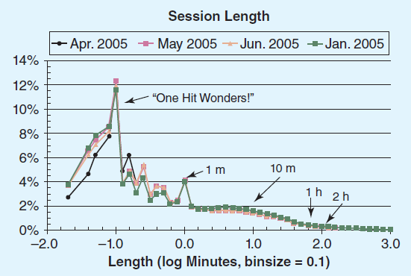
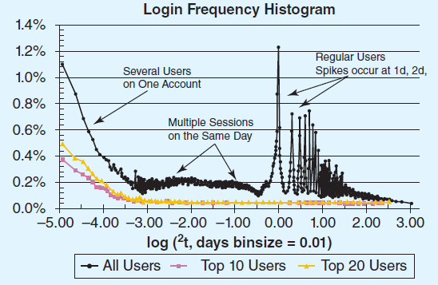
Web analytics

Slide 9
How question design affects data analysis
Question design affects analysis
Open question: each answer analysed separately
Closed question: analysed quantitatively
Fixed alternative answers restrict what can be said in findings
4

Slide 10
Basic qualitative analysis
Looking for critical incidents
Helps to focus in on key events
Then analysis can proceed using specific techniques
Identifying themes
Emergent from data, dependent on observation framework if used
Inductive analysis
Categorizing data
Categorization scheme pre-specified
Deductive analysis
In practice, combination of inductive and deductive

Slide 11
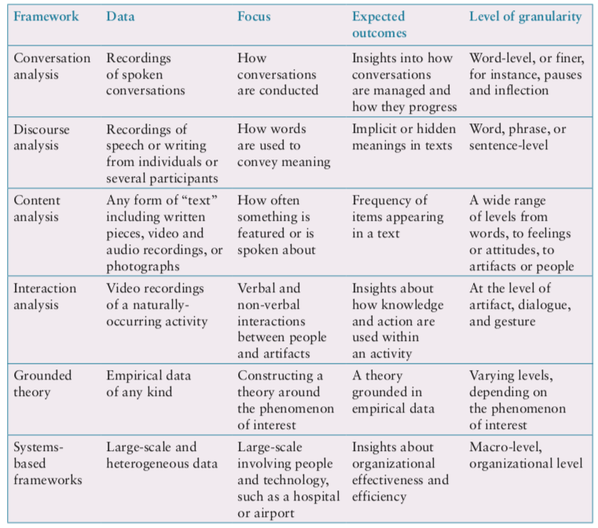
Which analytical framework?

Slide 12
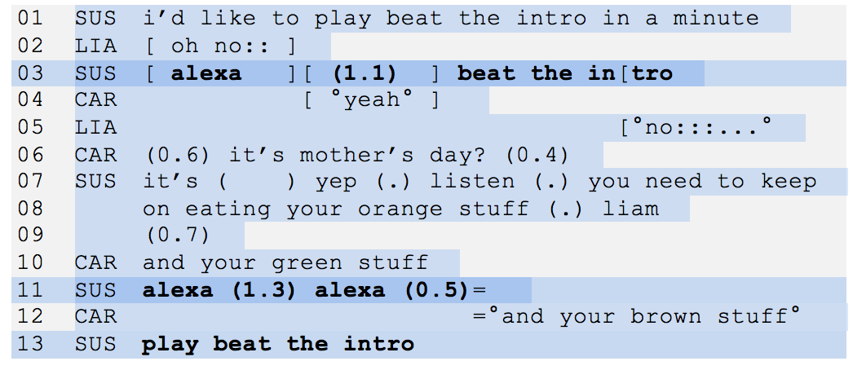
Conversation Analysis
Examines the semantics of a conversation in fine detail
An extract of the conversation between a family and Alexa

Slide 13
Discourse Analysis
Focuses on dialogue, i.e. the meaning of what is said and how words convey meaning
Assumption that there is no objective scientific “truth”
Language is viewed as a constructive tool
Discourse analysis is useful when trying to identify subtle meaning

Slide 14
Content Analysis
Involves classifying data into themes or categories, and studying their frequencies
Can be used for any “text”: video, newspapers, advertisements, images, sounds
Often used in conjunction with other techniques

Slide 15
Interaction Analysis
A way to investigate and understand interactions between people, and people and artefacts
Based on empirical observations such as videos
Inductive process in teams, collaboratively
Contents of the material is logged
Materials are extracted, classified or removed
Instances of a salient event are assembled and played one after the other
The team of researchers studies the assemblage together

Slide 16
Grounded Theory
Aims to develop theory from systematic analysis of empirical data
Three levels of ‘coding’
Open: identify categories
Axial: flesh out and link to subcategories
Selective: form theoretical scheme
Researchers are encouraged to draw on own theoretical backgrounds to inform analysis
Analytic tools to help stimulate:
Question the data
Analyse words, phrases or sentence
Comparisons between objects or abstract categories

Slide 17
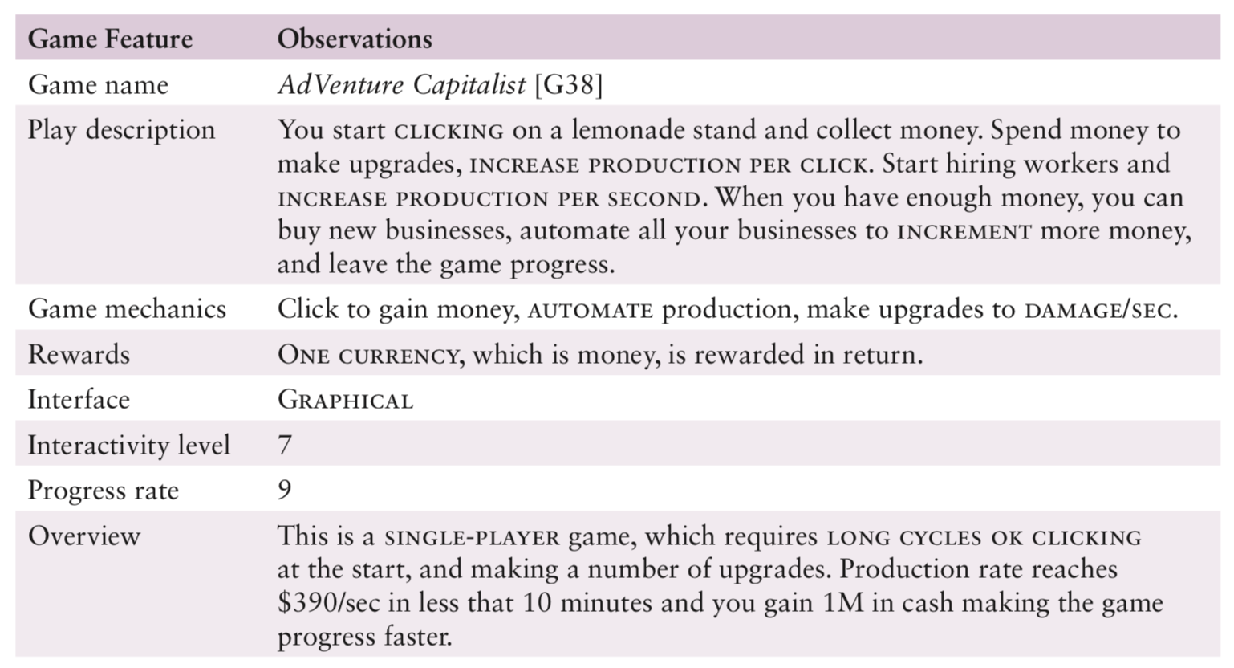
Illustration of open coding

Slide 18
Development of open coding
Source: Alharti et al (2018)

Slide 19
System-based frameworks
Understanding a whole socio-technical system requires different analytical framework
Socio-technical systems theory
Distributed Cognition of Teamwork

Slide 20
Distributed Cognition
The people, environment & artefacts are regarded as one cognitive system
Used for analyzing collaborative work
Focuses on information propagation & transformation

Slide 21
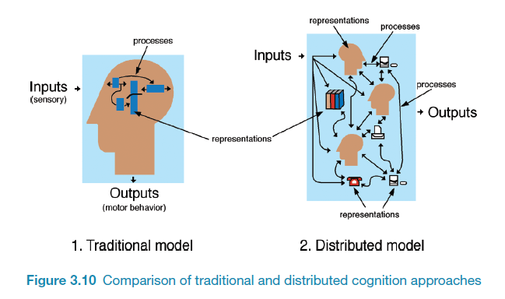
How it differs from information processing
Notes:
21

Slide 22
Resource Information structures
Plans
Action to be performed
Goals
Goals and sub-goals to be achieved
Current state
Current state of the world or interactive system
History
History of previous actions and what properties held of the state in the past
Action-effect model
Effect actions have on the system
Affordances
Affordances that the system current supports.

Slide 23
Resource configuration
A resource configuration is a collection of information structures that can be defined for each step in an interaction and which can be used to inform action
Resources can be external in an interface or represented in the head of the user
Interaction strategies link resource configurations to support decision making on actions

Slide 24
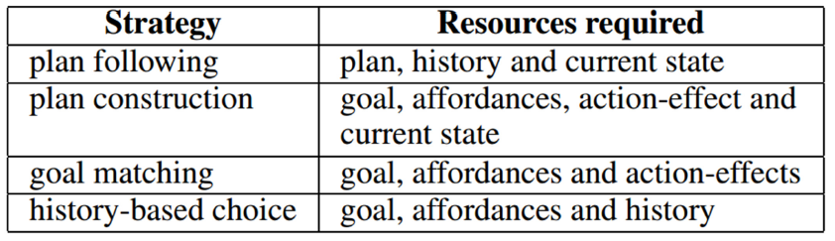
Interaction Strategies
Distributed across people, artefacts and environment
Resource allocation as part of user interface design and identification to support evaluation

Slide 25
Activity Theory
Explains human behaviour in terms of our practical activity in the world
Provides a framework that focuses analysis around the concept of an ‘activity’ and helps to identify tensions between the different elements of the system
Two key models: one outlines what constitutes an ‘activity’; one models the mediating role of artifacts

Slide 26
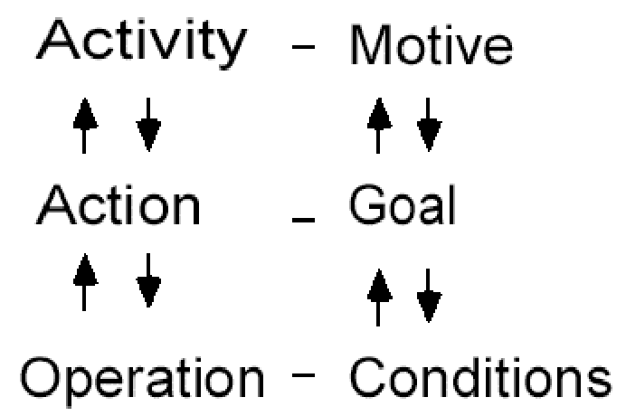
Individual model
16

Slide 27
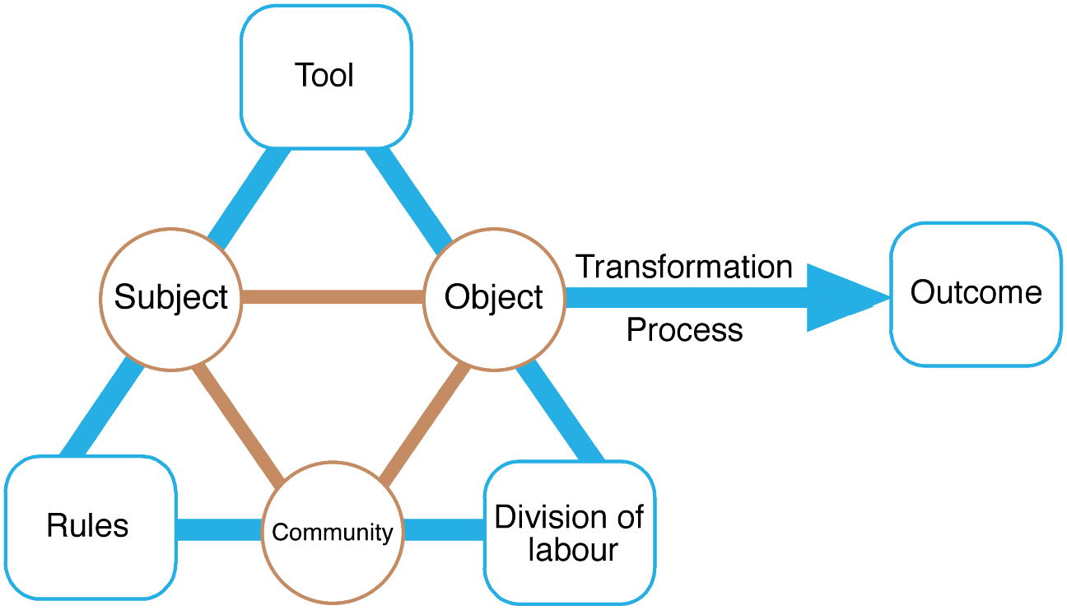
Engeström’s (1999) activity system model
17
Notes:
P312
Figure 8.17 Engeström’s (1999) activity system model. The tool element is sometimes referred to
as the mediating artifact
Source: Reproduced from Engeström, Y. (1999) Perspectives on Activity Theory, CUP.

Slide 28
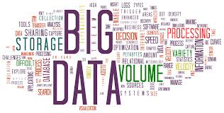
Tools to support data analysis
Spreadsheet – simple to use, basic graphs
Statistical packages, e.g. SAS and SPSS
Qualitative data analysis tools
Categorization and theme-based analysis
Quantitative analysis of text-based data
Nvivo and Dedoose support qualitative data analysis
CAQDAS Networking Project, based at the University of Surrey (http://caqdas.soc.surrey.ac.uk/)

Slide 29
Interpreting and presenting the findings

Slide 30
Interpreting and presenting the findings

Slide 31
Presenting the findings
Only make claims that your data can support
The best way to present your findings depends on the audience, the purpose, and the data gathering and analysis undertaken
Graphical representations may be appropriate for presentation
Stories are easy and intuitive approach to communicate ideas
Other techniques are:
Rigorous notations, e.g. UML
Create scenarios, narratives
Summarizing the findings

Slide 32
Summary
The data analysis that can be done depends on the data gathering that was done
Qualitative and quantitative data may be gathered from any of the three main data gathering approaches
Percentages and averages are commonly used in Interaction Design
Mean, median and mode are different kinds of ‘average’ and can have very different answers for the same set of data
Several analytical frameworks exist that focus on different levels of granularity with different purposes
Presentation of the findings should not overstate the evidence
19

Slide 33
You should now...
Know the difference between qualitative and quantitative data
Be aware of ways to analyze data from questionnaires, interviews and observation studies
Be aware of software packages to help with data analysis
Be able to consider common pitfalls in data analysis, interpretation and presentation

